Slide 1

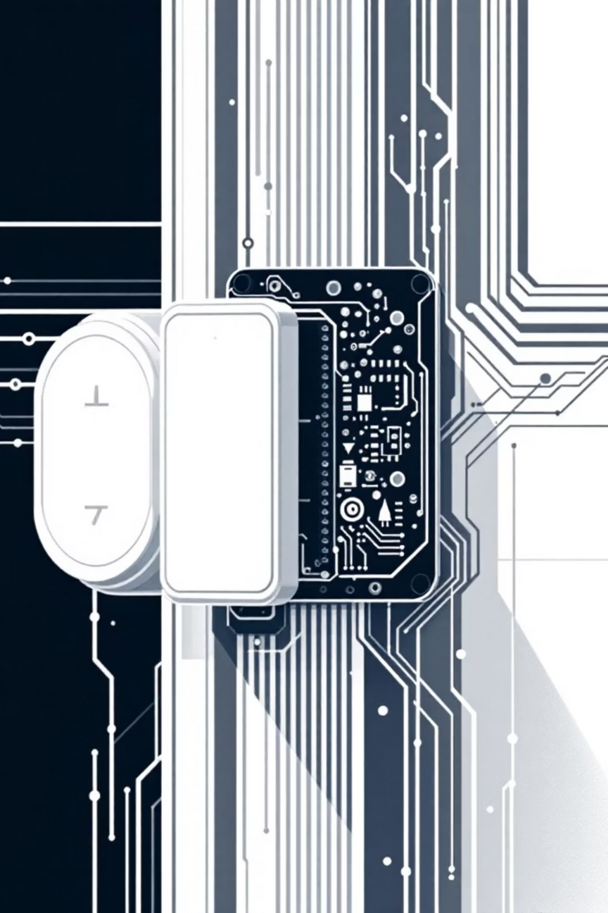


SecureHome
Motion-Triggered Door Lock with Keypad Authentication is an intelligent, secure access control system combining hardware and software for everyday applications

Slide 2






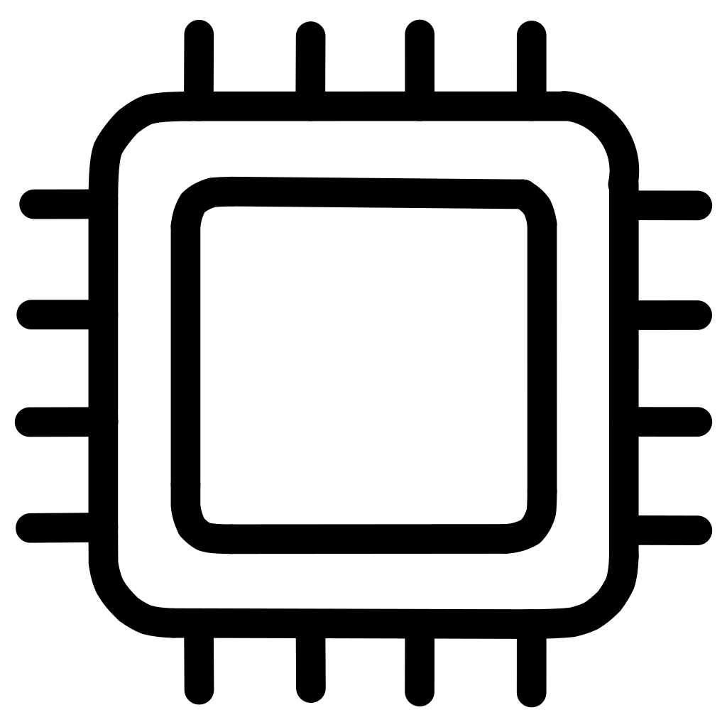

Motivation
Vulnerability Issues
Market Demand
Traditional mechanical locks remain susceptible to physical theft, key duplication, and unauthorized entry attempts.
Growing consumer interest in automated, intelligent home security systems driven by IoT adoption.
Technology Advantage
Educational Value
Embedded systems enable real-time monitoring, remote control capabilities, and instant security response.
Hands-on experience with microcontroller programming, sensor integration, and practical automation design.

Slide 3

Literature Survey
Previous Approaches
Our Innovation
Earlier models utilized RFID tags or Bluetooth connectivity for access control
PIR sensor integration enables hands-free, motion-activated system engagement
Password-based authentication proved cost-effective and reliable for residential applications
Enhanced user experience through automatic detection and response
Limited integration of intelligent sensing mechanisms in existing designs
Builds upon proven authentication methods with improved automation layer

Slide 4
Project Objectives
01
02
03
Password-Protected Authentication
Motion-Based Activation
Servo-Controlled Mechanism
Design and implement a secure, Arduino Uno-based door lock system with keypad password validation and user feedback mechanisms.
Integrate PIR sensor technology to enable automatic system wake-up when human presence is detected near the door.
Develop reliable door locking/unlocking control using servo motor actuation with LCD display and buzzer feedback for access status.

Slide 5
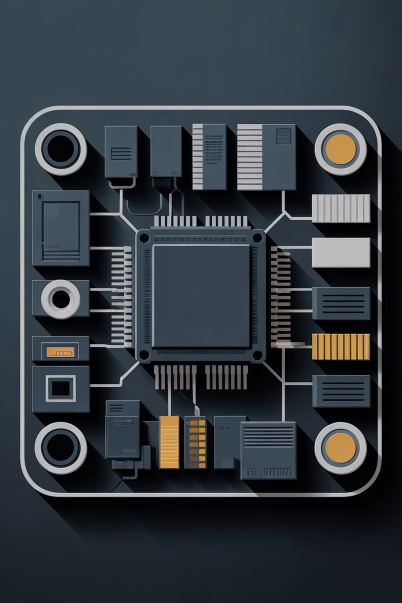



System Architecture
Input Layer
PIR Sensor + 4x4 Keypad
Processing Unit
Arduino Uno (ATmega328P)
Output Layer
Servo Motor + LCD + LEDs + Buzzer
The PIR sensor detects motion and triggers the Arduino to activate the keypad interface. User authentication through the keypad controls the servo motor, while the LCD, LEDs, and buzzer provide immediate visual and auditory feedback.

Slide 6
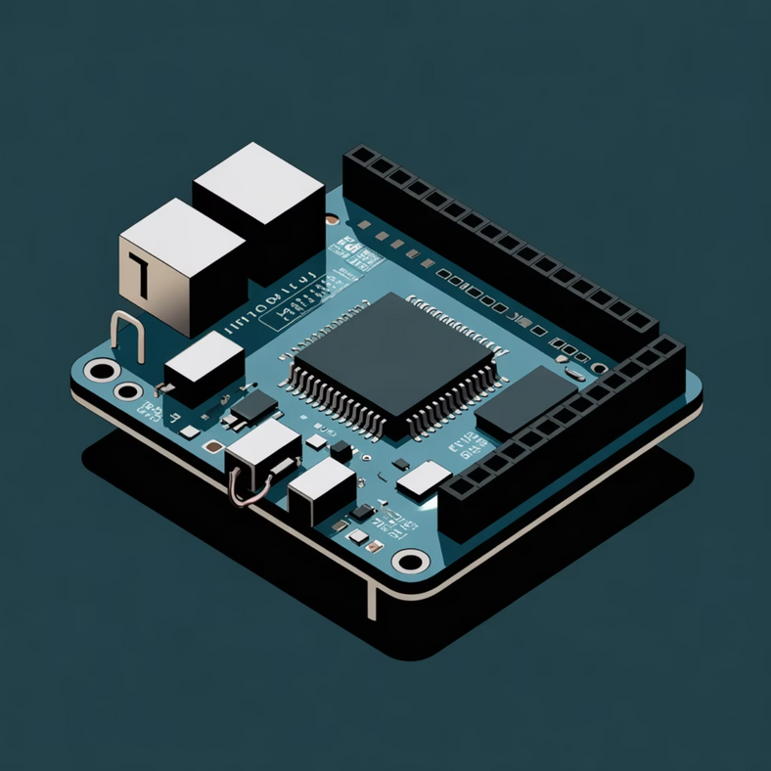
Arduino Uno — ATmega328P Specifications
Core Specifications
Architecture: 8-bit AVR RISC microcontroller
Clock Speed: 16 MHz crystal oscillator
Flash Memory: 32 KB (bootloader: 0.5 KB)
SRAM: 2 KB | EEPROM: 1 KB
Operating Voltage: 5V regulated
I/O Pins: 14 digital (6 PWM) + 6 analog
Power Supply: USB (5V) or external DC (7–12V recommended, 6–20V limits)

Slide 7

Processor Pinout Configuration
Digital I/O (D0–D13)
Analog Inputs (A0–A5)
Power Distribution
General purpose pins with PWM capability on D3, D5, D6, D9, D10, D11. D0/D1 reserved for serial communication.
10-bit ADC resolution for sensor readings. A4/A5 double as I2C communication pins (SDA/SCL).
5V and 3.3V regulated outputs, multiple GND pins, VIN for external power, and RESET for system initialization.

Slide 8



Platform Analysis
Applications & Advantages
Limitations
Memory Constraints: Limited 2 KB SRAM restricts
complex algorithm implementation
Smart Security
Ideal for access control, home automation, and IoT security applications
Processing Speed: 16 MHz clock insufficient for
computationally intensive tasks
Connectivity: No built-in wireless communication
(Wi-Fi/Bluetooth) requires external modules
Automation
Robotics, industrial control, and automated monitoring systems
Voltage Level: 5V logic may require level shifting
for 3.3V peripherals
Open Ecosystem
Extensive library support, low cost, and broad sensor compatibility

Slide 9
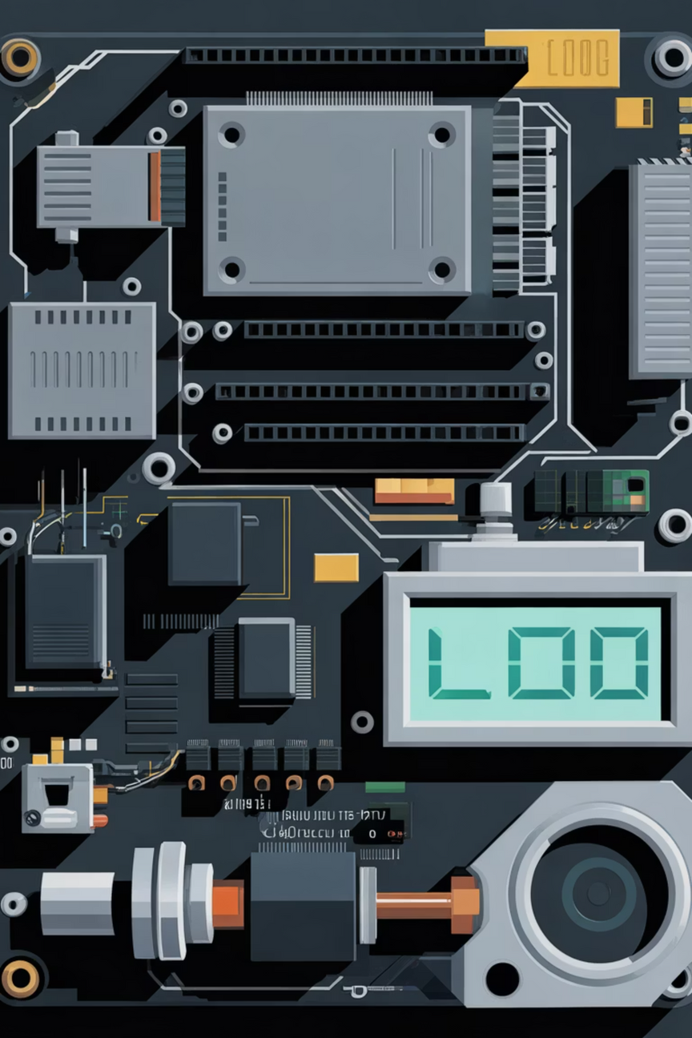
Circuit Design & System Operation
1
Motion Detection
PIR sensor (A3) detects presence and triggers LCD activation prompt
2
Authentication
User enters password via 4x4 keypad (D2–D9), displayed on I2C LCD (A4/A5)
3
Validation & Response
Correct: Servo unlocks (D10), green LED (D12), short beep. Incorrect: Red LED (D13), long buzzer alert (D11)
4
System Reset
Automatic timeout returns system to standby mode after access attempt
Power Distribution: 5V regulated supply powers Arduino, peripherals, and servo motor. Keypad uses pull-up resistor configuration for reliable input detection.

Slide 10
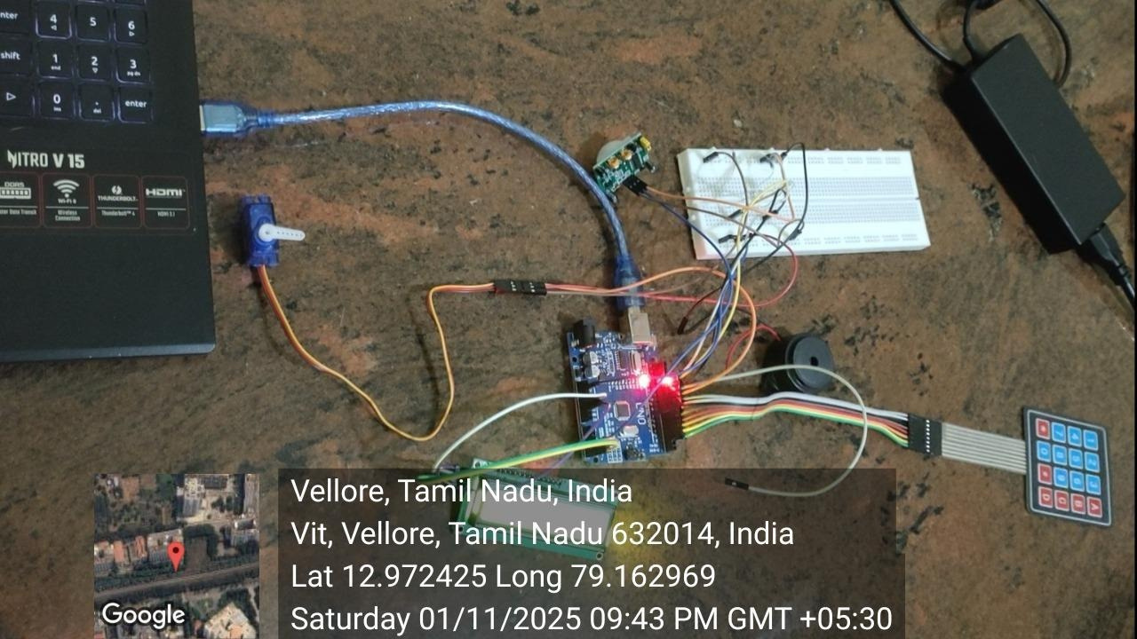
Photography of Project Work

Slide 11
Testing Results & Validation
Stage-wise Testing
Performance Validation
1
Parameter
Expected
Observed
PIR Sensor: Detected motion reliably at 2–5 meter range
PIR Detection
HIGH on motion
✓ HIGH
Servo Rotation
0° / 90°
✓ Accurate
2
LCD Display
Status visible
✓ Working
Keypad + LCD: Password entry and display functioning correctly
Response Time
<1.5s
✓ 0.8s avg
3
Authentication
100% accuracy
✓ Verified
Servo + Buzzer: Lock/unlock mechanism verified with audio feedback
All components performed within specification. The integrated system demonstrated reliable operation across multiple test cycles with consistent authentication accuracy.
4
Integrated System: Full functionality achieved with <1s response time

Slide 12
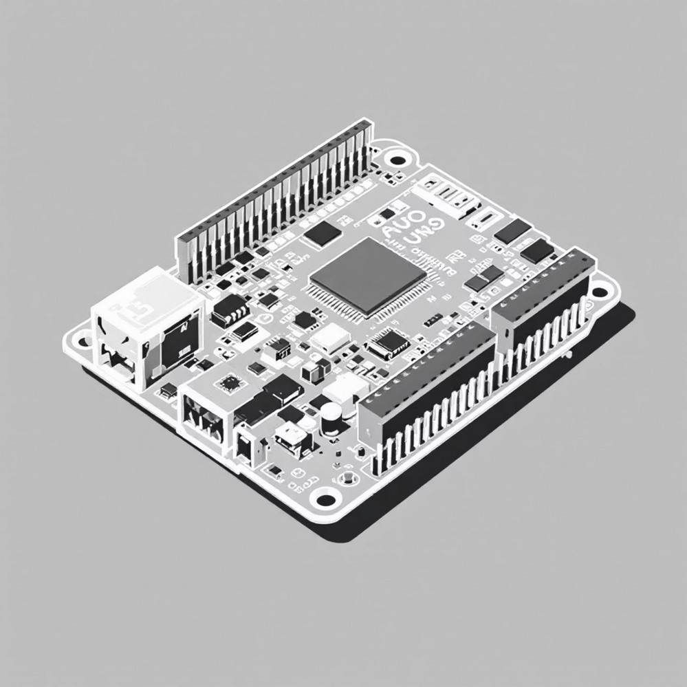
What is Arduino Uno R3?
The Brain of the Project
The Arduino Uno R3 is a microcontroller board based on the powerful ATmega328P chip. It serves as the central processing unit, controlling all components by receiving inputs and sending precise commands.
14 digital I/O pins for component control
6 analog inputs for sensor readings
USB interface for easy programming
Open-source platform with vast community support
Perfect for embedded projects like smart door locks, it combines accessibility with professional-grade capabilities.

Slide 13
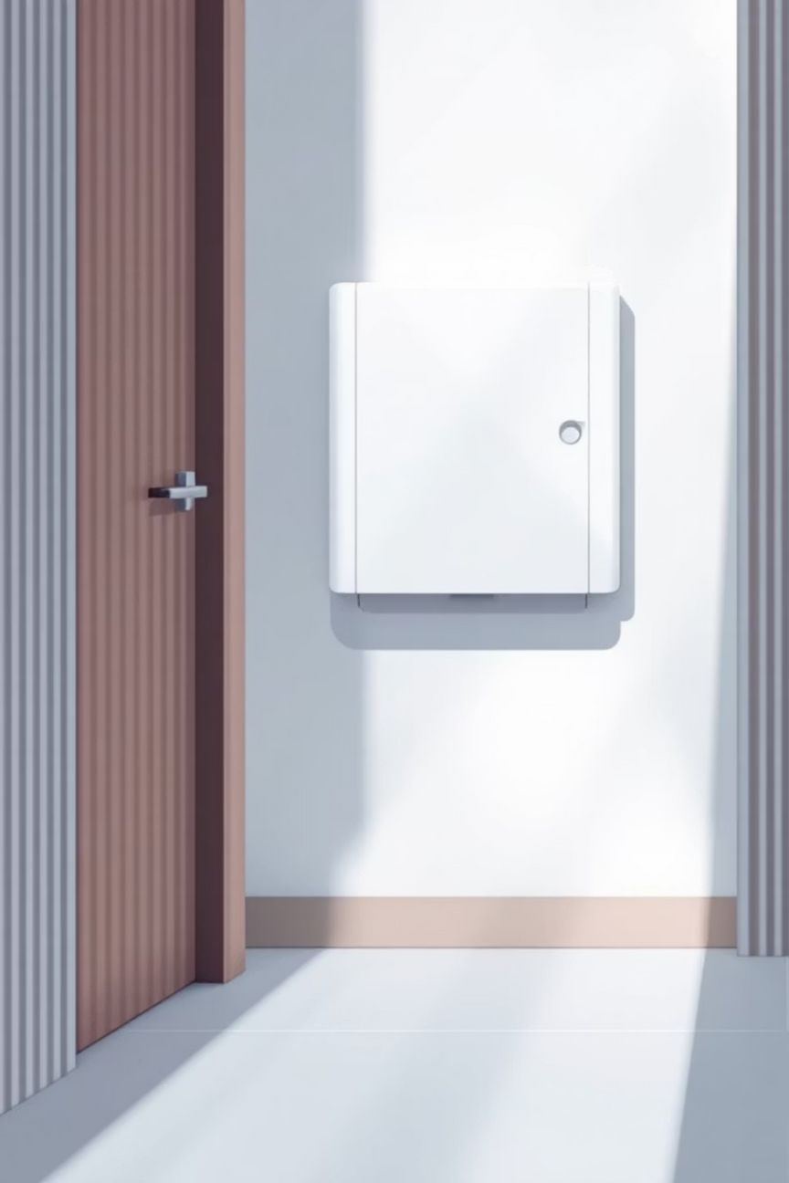






PIR Sensor (HC-SR501): Motion Detection
Detection Technology
Power Efficiency
Passive Infrared sensor detects human presence by sensing infrared radiation from body heat, triggering system activation automatically.
Keeps the system idle when no one is nearby, conserving energy and extending component lifespan significantly.
Customizable Range
Features adjustable sensitivity and delay time controls, allowing you to fine-tune detection range from 3 to 7 meters.

Slide 14

4x4 Matrix Keypad: Password Input Interface
16-Button Configuration
Digital Pin Connection
User-Friendly Design
Arranged in 4 rows and 4 columns, providing numeric keys 0-9 plus special function keys (* and #) for versatile password entry.
Connected to Arduino digital pins using a scanning technique that reads row and column states to detect which key is pressed.
Supports special keys for clearing incorrect input or confirming password entry, making the interface intuitive and error-tolerant.

Slide 15
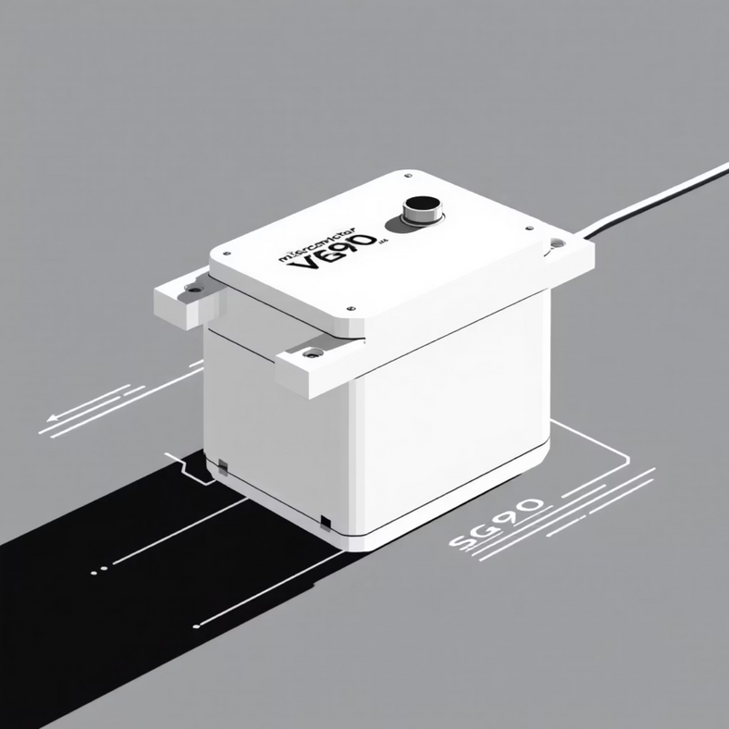
Servo Motor (SG90): Door Lock Actuator
Precision Mechanical Control
The SG90 is a compact servo motor that provides precise rotational movement to physically lock or unlock the door bolt mechanism.
01
02
PWM Signal Control
Low Power Operation
Arduino sends Pulse Width Modulation signals to position the servo between 0° (locked) and 90° (unlocked).
Draws minimal current during operation, typically 10-15mA at idle and up to 200mA under load.
03
Tactile Feedback
Provides audible and physical confirmation when the door state changes, enhancing user confidence.

Slide 16
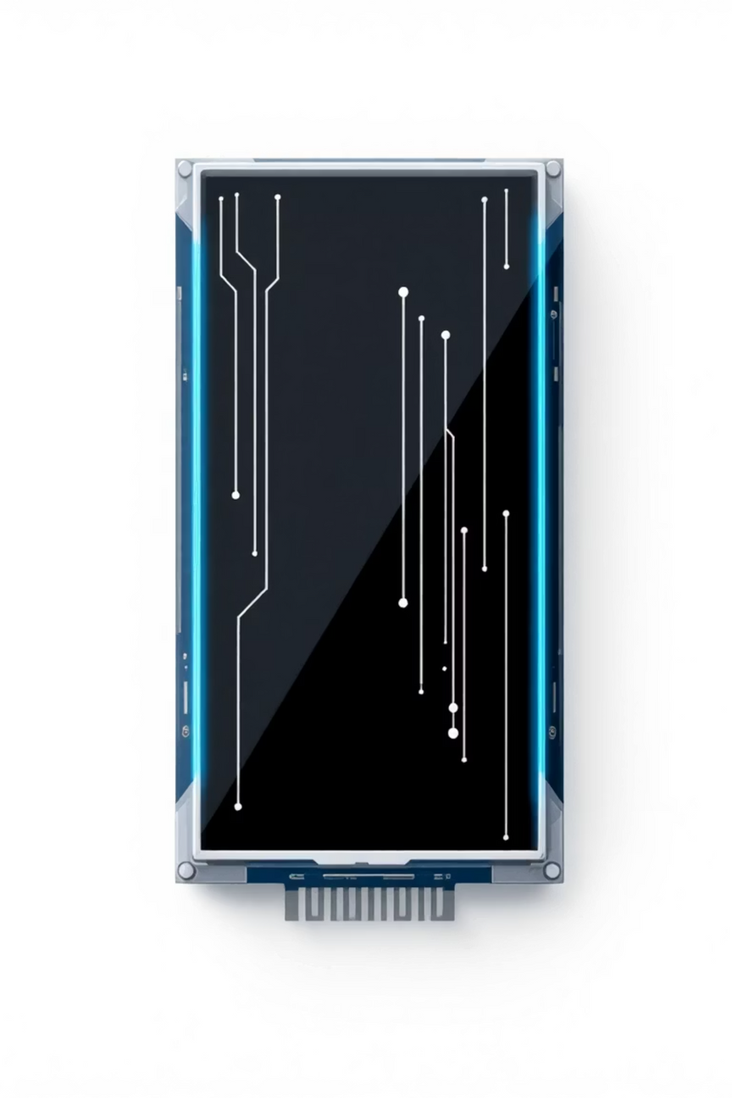



16x2 LCD Display with I2C Module
Real-Time User Feedback
Displays clear prompts like "Enter Password", "Access Granted", or "Access Denied" to guide users through the authentication process.
Simplified Wiring
The I2C module reduces complexity by using only two data lines (SDA and SCL) instead of 16 pins, making assembly much cleaner.
Development Aid
Invaluable for debugging and monitoring system behavior during development and troubleshooting phases.

Slide 17
Active Buzzer & LEDs: Alerts and Status Indicators
🔴 Red LED
🟢 Green LED
🔊 Active Buzzer
Locked State Indicator
Success Signal
Audio Alerts
Illuminates when the door is locked or when an incorrect password is entered, providing immediate visual feedback of system status.
Lights up when authentication succeeds and the door unlocks, confirming authorized access to the user.
Sounds on each keypress for feedback and produces distinctive tones for wrong password attempts, enhancing security awareness.
These simple components, wired to Arduino digital pins with 220Ω resistors for LED protection, dramatically improve usability and create a professional user experience.

Slide 18
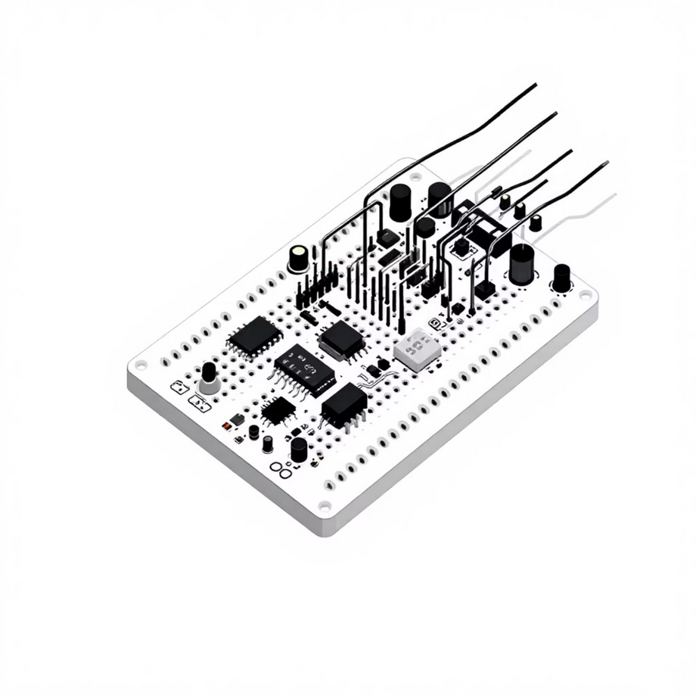
Resistors, Breadboard & Jumper Wires
Circuit Essentials for Prototyping
1
Resistors
220Ω resistors limit current to LEDs, preventing burnout. 10kΩ resistors stabilize signals and provide pull-down/pull-up configurations.
2
Breadboard
Enables solderless assembly and rapid testing of the circuit. Makes it easy to modify connections and troubleshoot issues.
3
Jumper Wires
Connect all components to Arduino pins with flexibility. Color-coded wires help organize power, ground, and signal lines clearly.

Slide 19
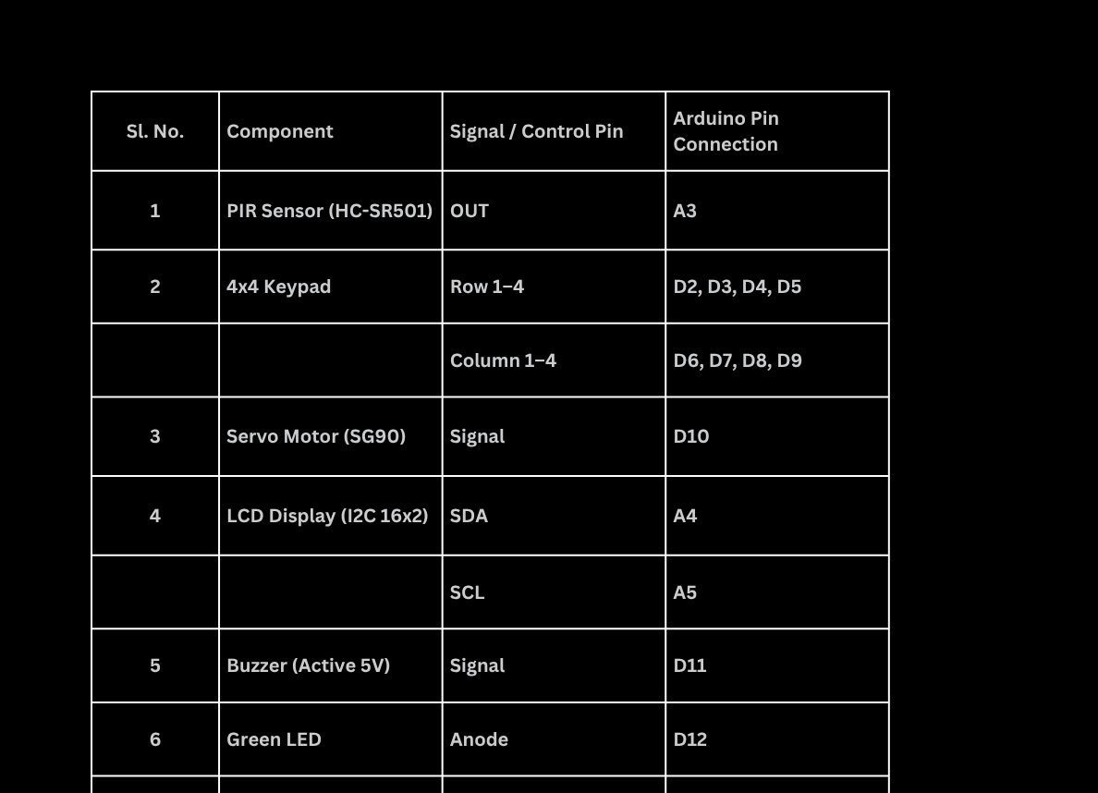
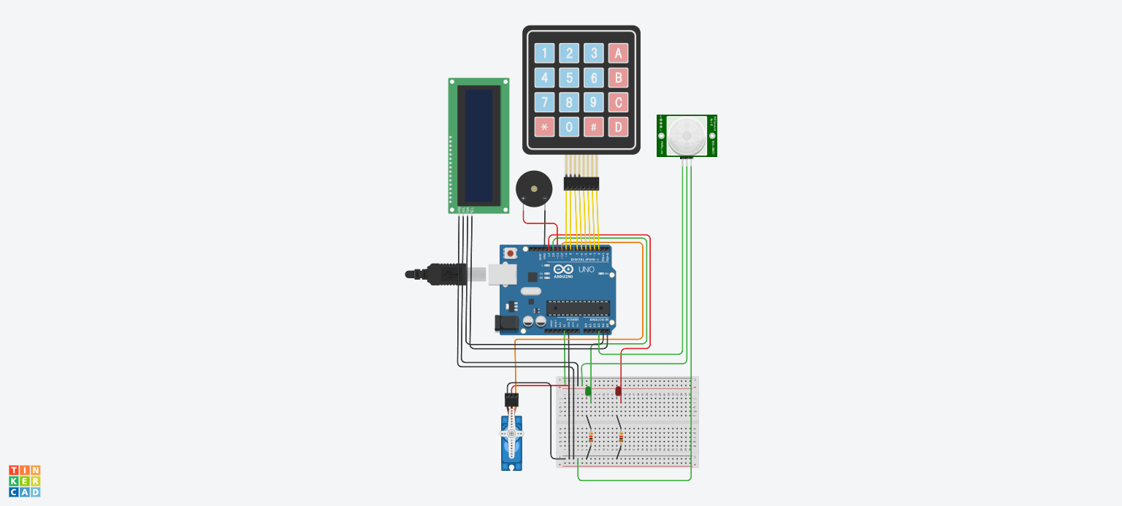

Slide 20






How It All Works Together
System Operation Flow
Motion Detection
PIR sensor detects human presence and triggers Arduino to activate the keypad input system
Password Entry
User enters password on keypad while LCD displays prompts; Arduino captures and verifies the input code
Authentication
Arduino compares entered password with stored code and determines access permission
Access Granted
Servo motor rotates to unlock position, Green LED illuminates, LCD shows "Access Granted" message
Access Denied
Wrong password triggers buzzer alert, Red LED lights up, LCD displays "Access Denied" warning
Auto-Lock Reset
After timeout period, servo returns door to locked position and system resets for next user

Slide 21
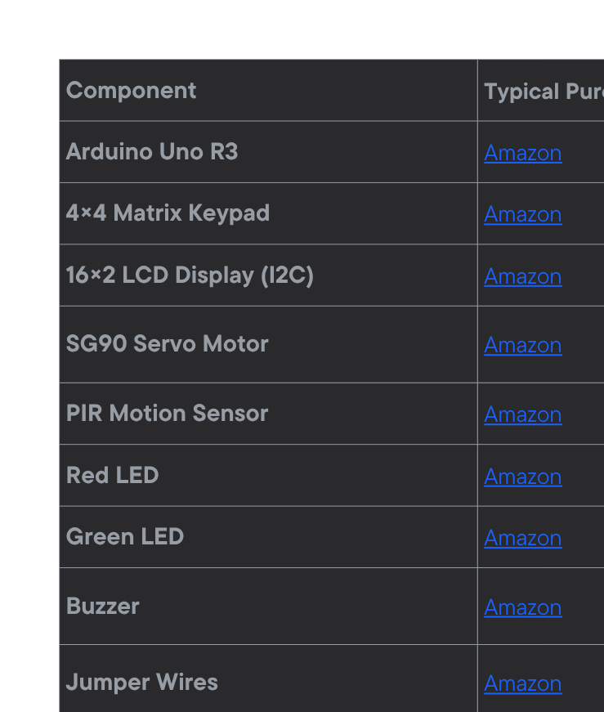
Components & Purchase Links

Slide 22
Related Websites & Tutorials
https://circuitdigest.com/microcontroller-projects/digital-keypad-security-door-lock-using-arduino?utm_source=chatgpt.com
https://projecthub.arduino.cc/jayesh_nawani/door-lock-system-with-arduino-54d18a https://roboelectrixx.com/arduino-based-door-lock-system-with-password/
[Complete Tutorial] IoT Door Lock Project Using Arduino - Complete circuit and code

Slide 23
Project Video

Slide 24
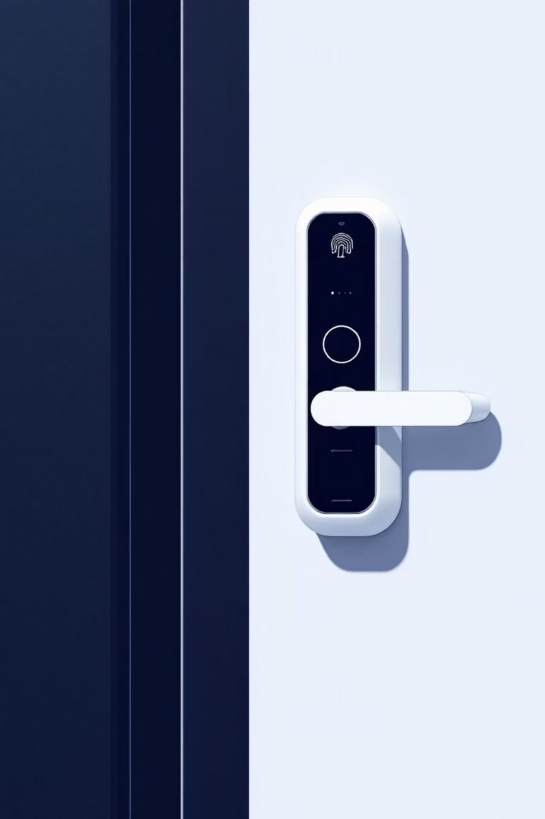






Conclusion & Future Enhancements
Secure & User-Friendly
Cost-Effective Solution
This Arduino Uno door lock offers robust access control combining motion detection, password authentication, mechanical locking, and multi-sensory feedback.
Highly customizable and affordable for home or office security applications, with total component cost under $50.
Upgrade Possibilities
Future enhancements: integrate RFID cards, smartphone Bluetooth/WiFi control, fingerprint authentication, or remote access monitoring.

